Slide 1
Tapia WRF Flow Equalization Project: Design Award
January 5, 2026

Slide 2
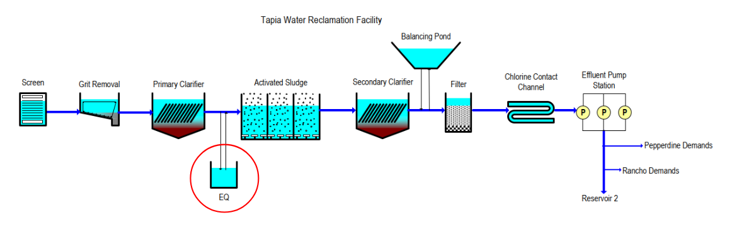
Purpose of Flow Equalization Project
Introduction of new primary storage volume at Tapia to improve overall treatment performance

Slide 3
Benefits of Flow Equalization
Tapia WRF Benefits:
Reduction in peak flows through the plant during storm events and daily diurnal variations
Provides staff the opportunity to stabilize flow rates through secondary treatment and tertiary filtration
Improvements to overall treatment performance and effluent quality
AWPF Benefits:
Reduces variability of influent flow rates at AWPF, reducing operational complexity
Additional storage for future water augmentation sources (such as urban water diversion)

Slide 4
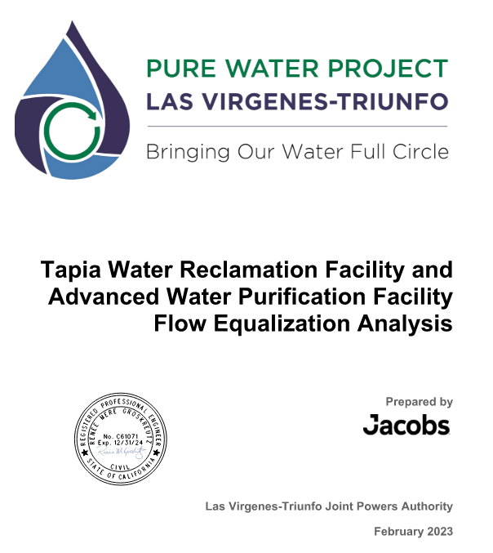
Existing Analysis
In 2023, a study was conducted to analyze options for flow equalization in support of the AWPF
Recommended construction of a 1.0 to 5.0 MG equalization basin, with 3.0 MG being sufficient for the majority of peak storms

Slide 5
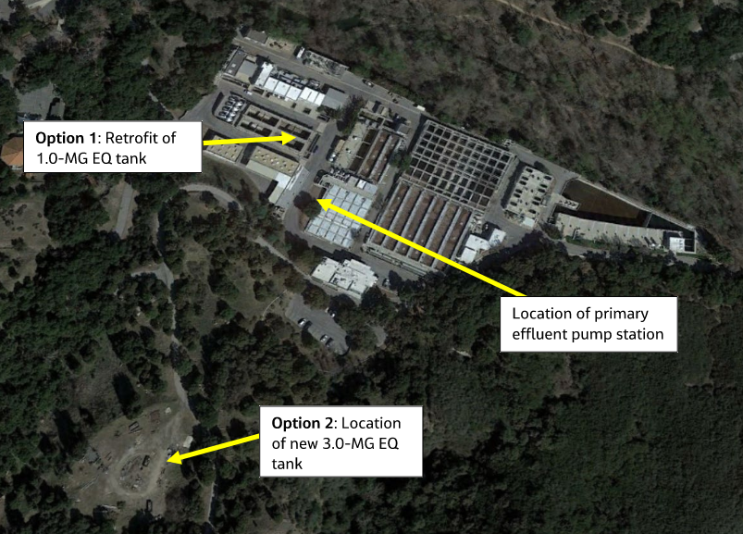
Potential Locations
Initial concepts include:
Reuse of existing abandoned digester tanks
New tank in existing storage yard
Combination of the two options
Location selection will impact achievable storage volume, pumping costs, and capital cost

Slide 6
Request for Proposals for Design Services
Publicly advertised on OpenGov in August 2025
Scope of Services:
Review of previous equalization study and updating existing technical memorandum (including confirmation of sizing)
Site selection study
Basis of Design Report (BODR)
Design Development (60%, 90%, 100%)
Bidding and Construction Services

Slide 7
Proposals Received
Four Proposals Received (~$1.2M to $1.5M):
Atkins Realis
Cannon
PACE
Stantec
Through extensive deliberation and review by a panel of Staff evaluators, Stantec was selected as the most comprehensive and cost-effective proposal (which was further negotiated to produce the best value for the JPA)

Slide 8
Qualifications
Stantec has a well-qualified team that has completed similar projects across the state (including equalization at the Hyperion Water Reclamation Plant)
Has successfully worked with the JPA team in the past, including the Tapia Summer Season Waste Load Allocation Compliance Project completed in December 2024

Slide 9
Recommendation
Accept the proposal from Stantec and authorize the Administering Agent/General Manager to execute a professional services agreement in the amount of $1,172,065.50 for design, bidding and engineering support services for the Tapia WRF Flow Equalization Project.

